Slide 1
Northeast Park Neighborhood Meeting
Pat Hilden Manager Field Operations
Inspections Services

Slide 2
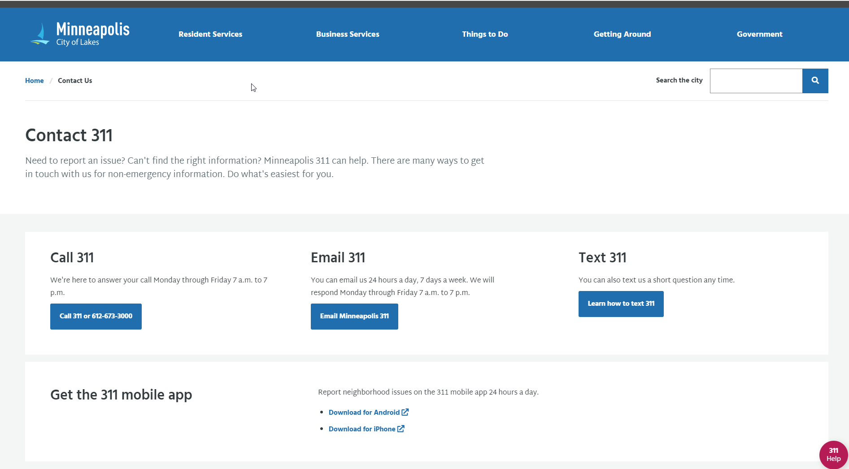
https://www.minneapolismn.gov/contact-us/

Slide 3
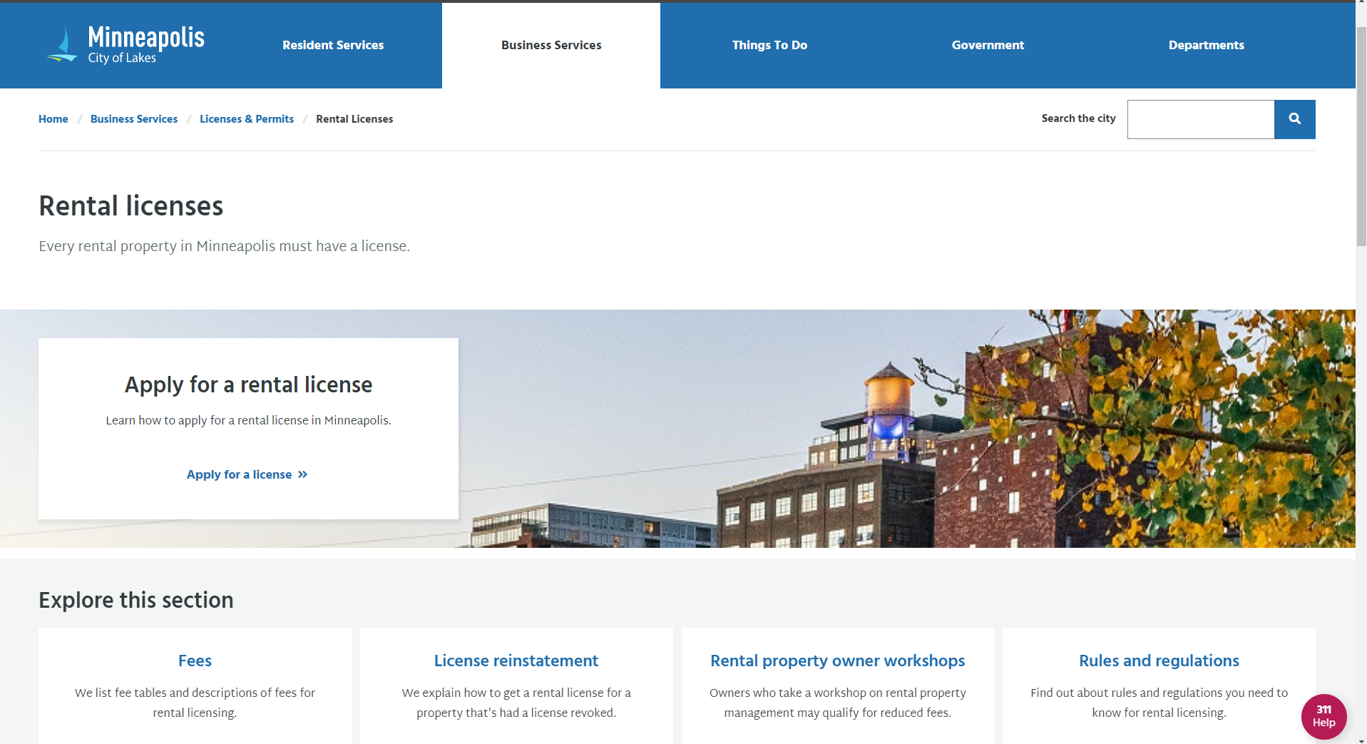
https://www2.minneapolismn.gov/business-services/licenses-permits/rental-licenses/

Slide 4
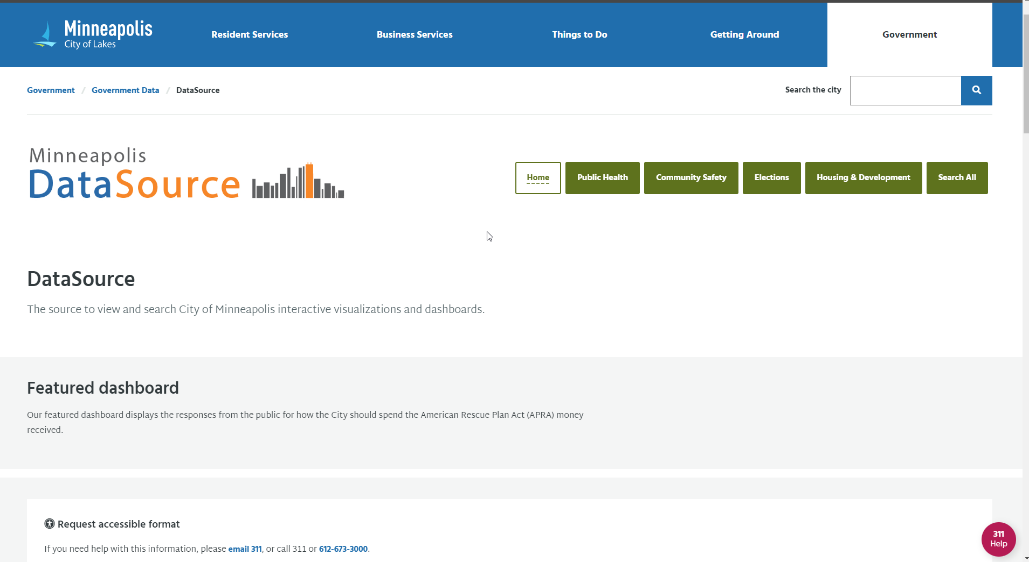
https://www.minneapolismn.gov/government/government-data/datasource/

Slide 5
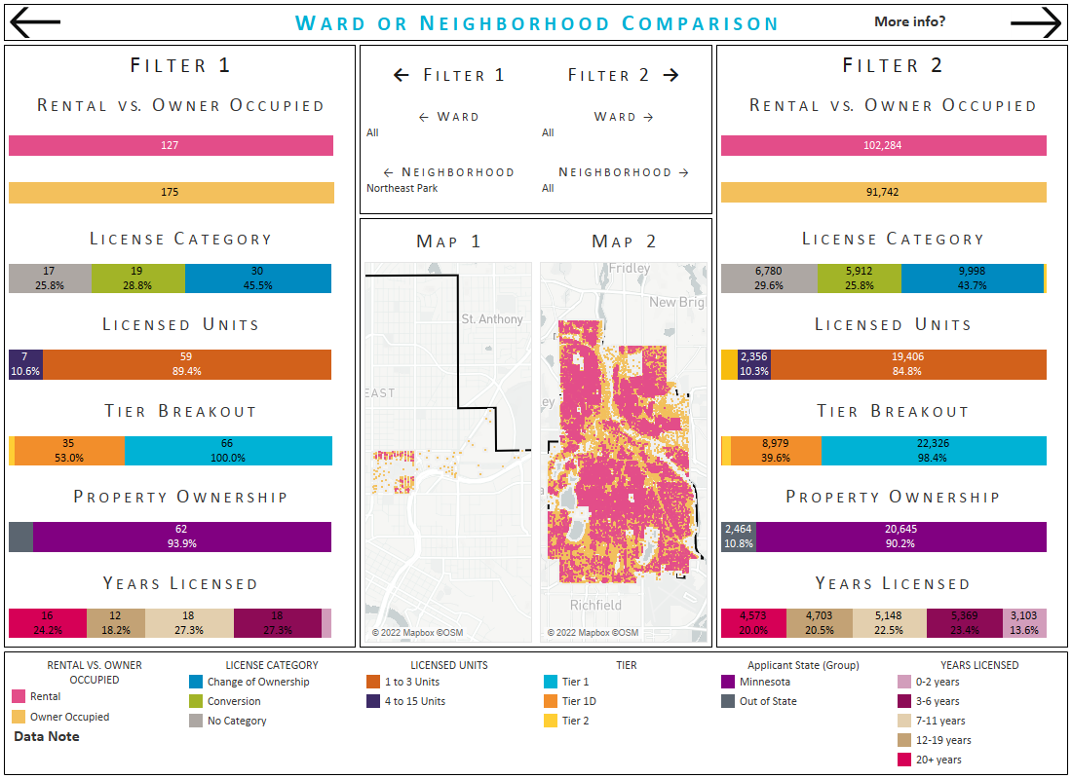

Slide 6
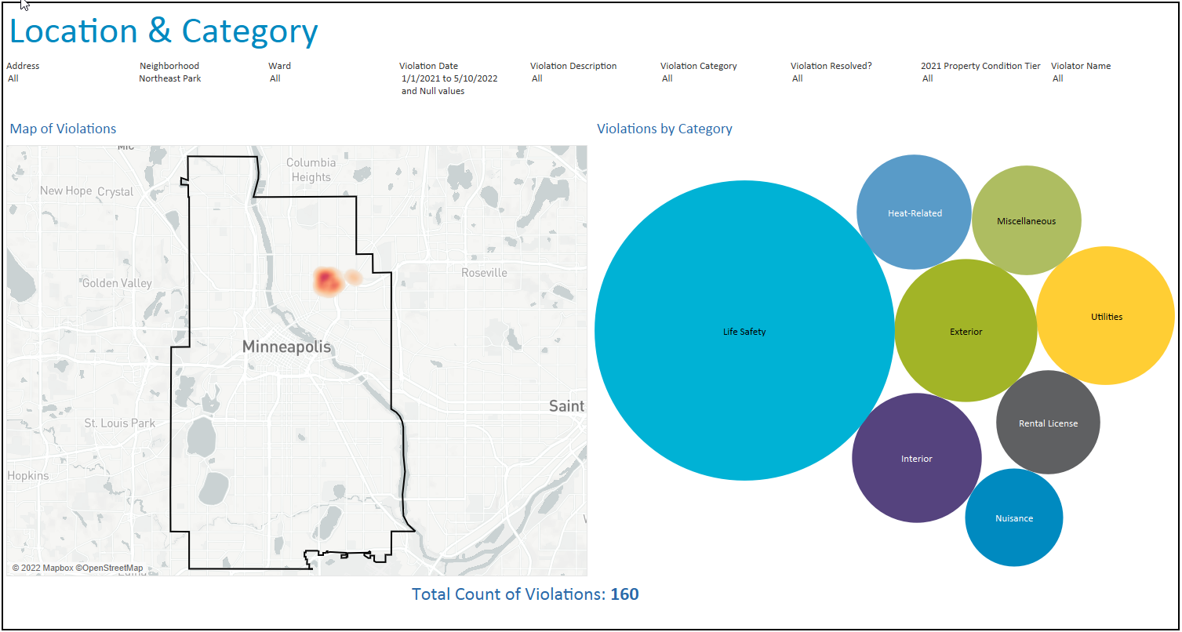
Housing Violations for Northeast Park

Slide 7
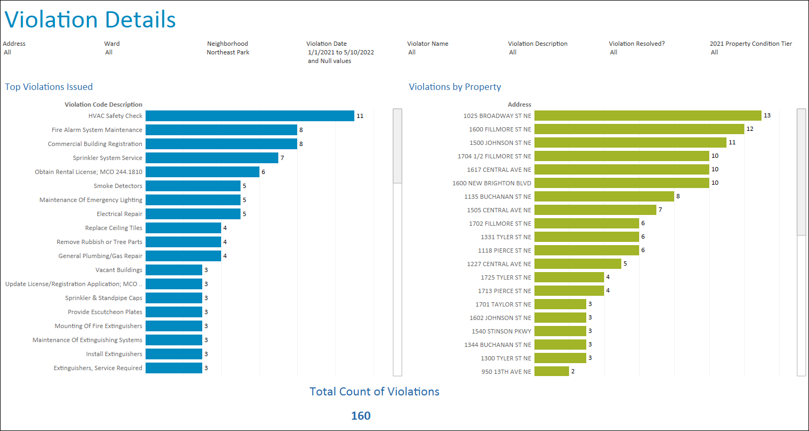
Housing Violation Details Northeast Park

